Slide 1
Capstone Project- The battle of Neighborhood

Slide 2
Problem statement
Charlotte is a one of the most populous city of USA. Between 2004 to 2014, charlotte was rank as fastest growing metro area with 880000 more resident. (Per Wikipedia). Opportunity of opening new business and being successful is real. Being there are many different kinds of business ideas, opening a restaurant is on top of the list for my customer. Before they think about other things require to open a restaurant, they would like to do assessment on different area based on area, nearby restaurant etc. This will help them compare and decide best location.

Slide 3
Description of Data
Based on the problem that we are trying to solve, assessment on following list based on zip code would be important.
Zip code list of the charlotte
Near by Restaurant
We will use
https://docs.gaslamp.media/download-zip-code-latitude-longitude-city-state-county-csv/ - To get list of zipcode in charlotte area
Number of restaurants and their type and location in every neighborhood will be obtained using Foursquare API

Slide 4
Methodology
In this section we will be doing following steps
Collect Inspection Data
Explore and Understand Data
Data preparation and preprocessing
Modeling

Slide 5
Methodology
In this section we will be doing following steps
Data collection
Explore and Understand Data
Data preparation and preprocessing
Modeling

Slide 6
Data collection
In this section import libraries
Read CSV file- http://docs.gaslamp.media/wp-content/uploads/2013/08/zip_codes_states.csv

Slide 7
Data preparing and processing
Imported data look as below.
It is collection of all counties, cities and states data.
zip_code | latitude | longitude | city | state | county
0 | 501 | 40.922326 | -72.637078 | Holtsville | NY | Suffolk
1 | 544 | 40.922326 | -72.637078 | Holtsville | NY | Suffolk
2 | 601 | 18.165273 | -66.722583 | Adjuntas | PR | Adjuntas
3 | 602 | 18.393103 | -67.180953 | Aguada | PR | Aguada
4 | 603 | 18.455913 | -67.145780 | Aguadilla | PR | Aguadilla

Slide 8
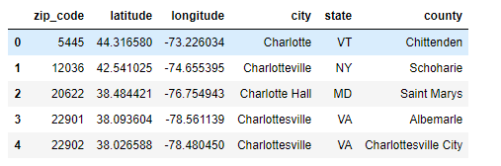
Data preparing and processing
Extract all rows containing city name Charlotte.

Slide 9
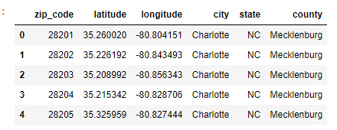
Data preparing and processing
Filter all rows for state NC.

Slide 10
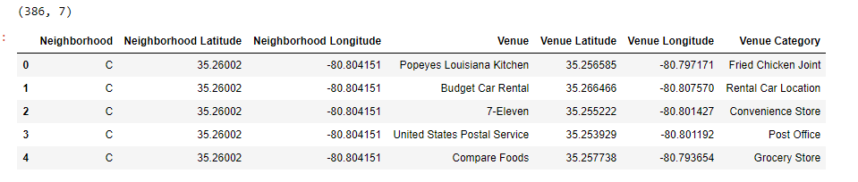
Data preparing and processing
As the table suggest, we have list of different zip codes with its location data.
Use Foresquare API to collect nearby locations in different neighborhood in Charlotte within radios of 1000 meter.
Groupby data with neighborhood.

Slide 11
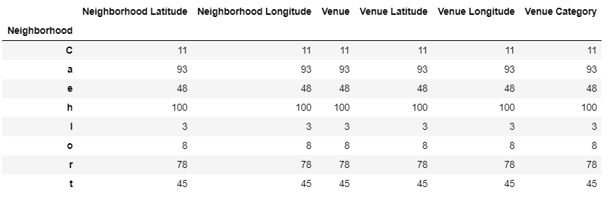
Data preparing and processing
After group by data with Neighborhood.

Slide 12
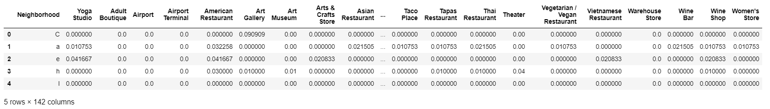
Data preparing and processing
Apply one hot encoding on Charlotte grouped Data frame.

Slide 13
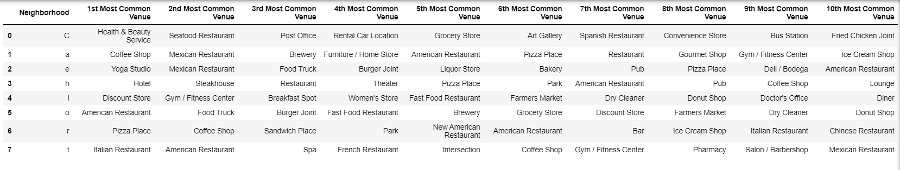
Modeling
Apply K-means clustering.
Find top 10 most common venues in each neighborhood

Slide 14
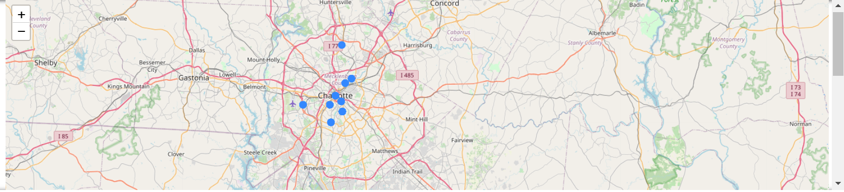
Map

